Slide 1





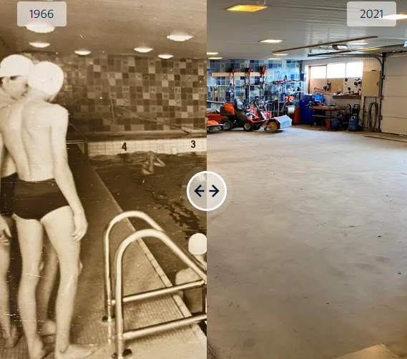
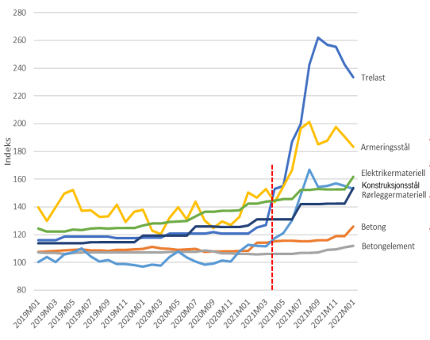
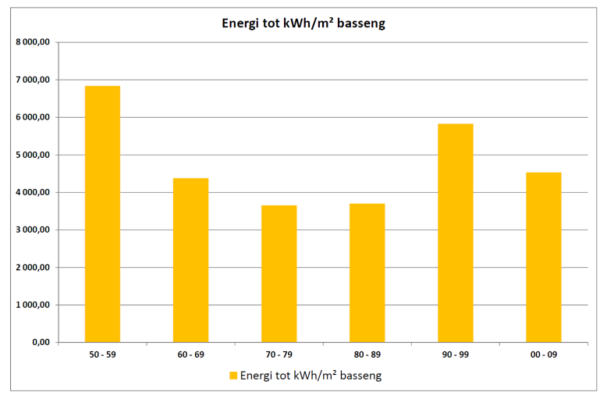
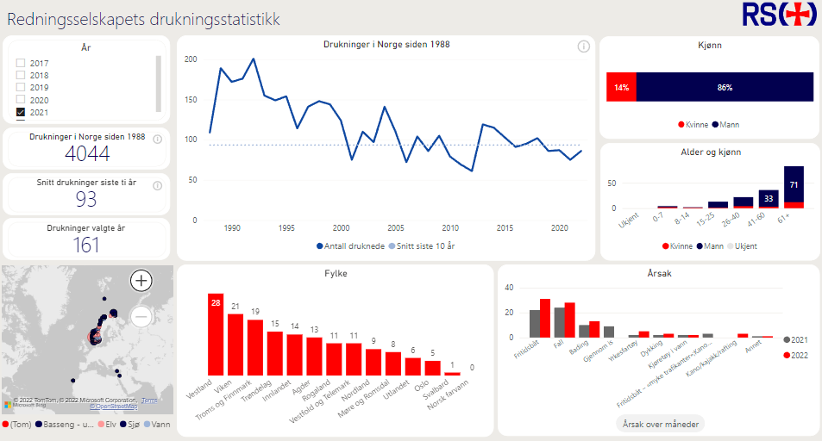
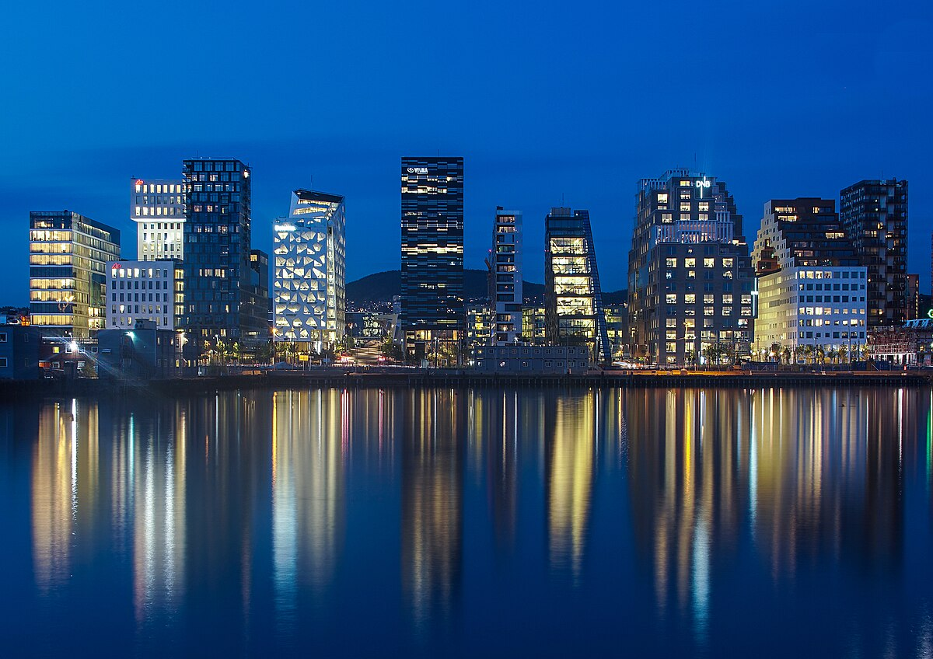
The dilemma
Swimming ability
Pool scarsity
Cost
Environment
Location
Swimming ability saves lives
Many countries see a negative trend in swimming ability among children
Only 43% of Norwegians can swim +200 m (NSF 2021)
Lack of pools is a significant reason for poor swimming ability
Many old pools are shut down without being replaced
Population growth mainly in urban areas, where pool access is increasingly limited
Traditional swimming pools are costly to build and operate - Cost has doubled from 2019 to 2025
Invreased pressure on construction materials as steel, concrete, wood, etc.
Stringent requirements for air quality lead to increased cost
Traditional swimming facilities are energy demanding to construct and operate
Construction materials as steel, concrete and glass come with a significant carbon footprint
Pools should be available close to where people live
Densely populated areas normally have high cost of property
Floating facilities may be very cost efficient
High number of drownings
Shut-down pool in Ulefoss
Escalating cost for construction materials
Outdoor pools (red line) save energy
City centres – High cost for land
Indoor swimming pools were built in Europe from late 1800’s; not to teach people to swim but to keep them clean
Indoor swimming pools were built in Europe from late 1800’s to keep the population clean – Not to learn them to swim!
Notes:
Vurder om vi har tid. Ta svømmeferdighet under utendørs svømming?

Slide 2
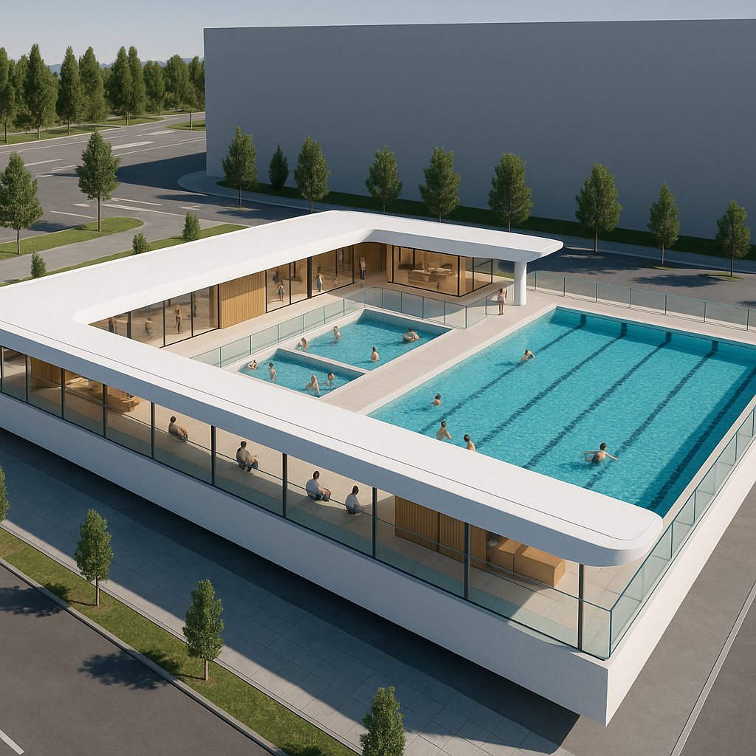
Case study – Public, outdoor pool facility
Estimated turn-key cost: 5 M EURO
Investment savings: 85% compared to a traditional indoor solution
Operational savings: 60% compared to a traditional indoor solution
Private ownership with +15% ROE – Opens up for a national chain/membership model?
Global market potential for solution and operating model: Design One – Build Many

